Slide 1
LeNet5 EEG
Ronald Broberg
Oct 27 2014
CS5870

Slide 2
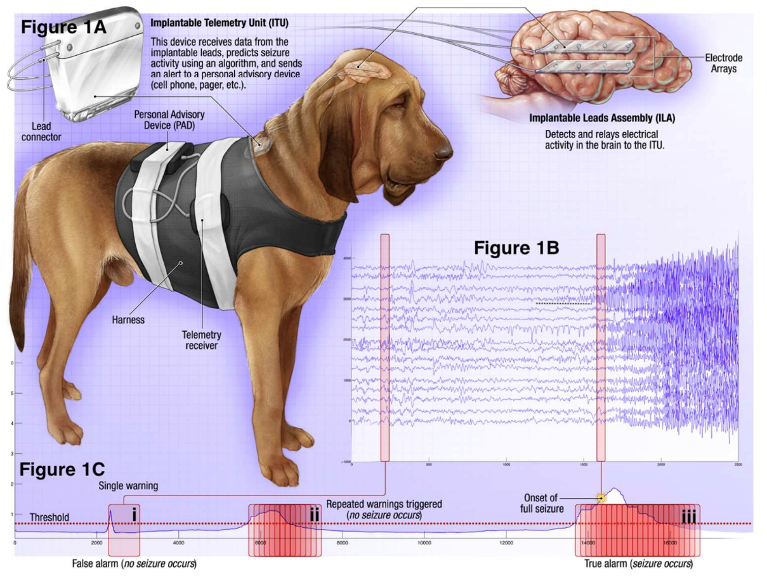
Epileptic Seizure Prediction
Classify 10 minute segments of EEG Data
As Preictal or Interictal
http://www.kaggle.com/c/seizure-prediction
https://kaggle2.blob.core.windows.net/competitions/kaggle/3800/media/DogRecordingSystem.png

Slide 3
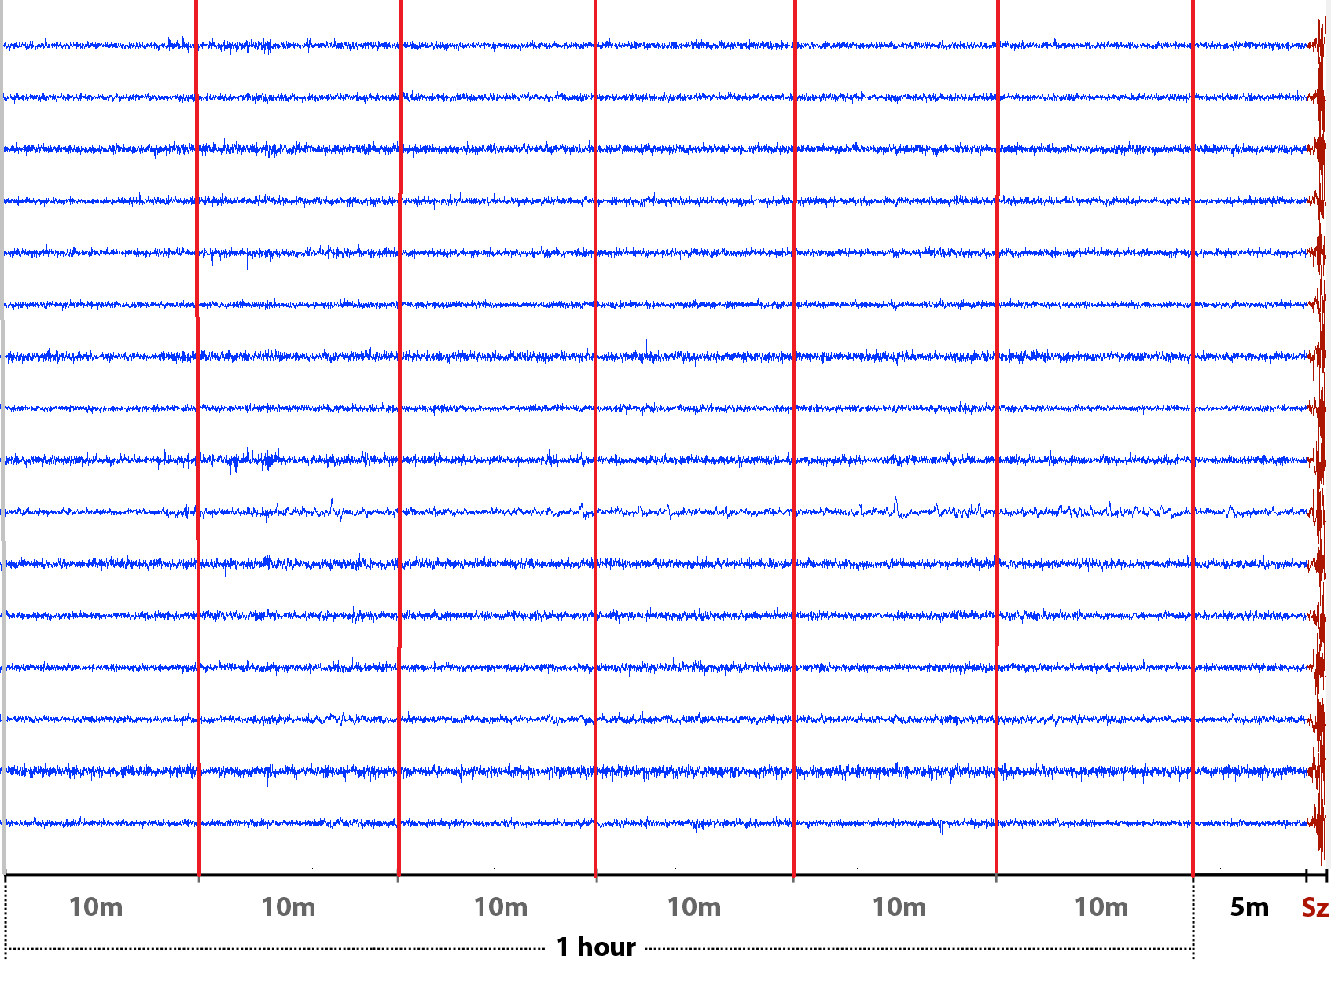
Preictal Data Selection
For each patient
For each seizure
Select 1 hour of data
Terminating ~315 seconds prior to seizure
Split into 6 10 minute segments
http://www.kaggle.com/c/seizure-prediction/data
https://kaggle2.blob.core.windows.net/competitions/kaggle/3960/media/Preictal1hr1m_annot.png

Slide 4
Data Characterization
Case | Freq | Chans | Preictal | Interictal | Test | Seizures | Sz Trained
Dog_1 | 240 | 16 | 24 | 480 | 502 | 4 | 3
Dog_2 | 240 | 16 | 42 | 500 | 1000 | 8 | 5
Dog_3 | 240 | 16 | 72 | 1440 | 907 | 12 | 8
Dog_4 | 240 | 16 | 97 | 804 | 990 | 16 | 11
Dog_5 | 240 | 15 | 30 | 450 | 191 | 5 | 3
Patient_1 | 4500 | 15 | 18 | 50 | 195 | 3 | 2
Patient_2 | 4500 | 24 | 18 | 42 | 150 | 3 | 2

Slide 5
ETL
Converted from MATLAB binary data storage to HDF5 format
Down sampled to 200 Hz
Features extracted with Julia
Stored as csv

Slide 6
Feature Selection
Univariate
Variance
Autocorrelation
Amplitude Entropy
Kurtosis
Skew
Bivariate
Cross-correlation

Slide 7
Feature Preparation
For each case
For each segment
Import 10 minute down sampled data with n-channels
Split along time into (n^2-n)/2 segments (~5 seconds)
Calculate cross-correlation for (n^2-n)/2 unique pairs of channels
Assuming no time lag
Store as vector

Slide 8
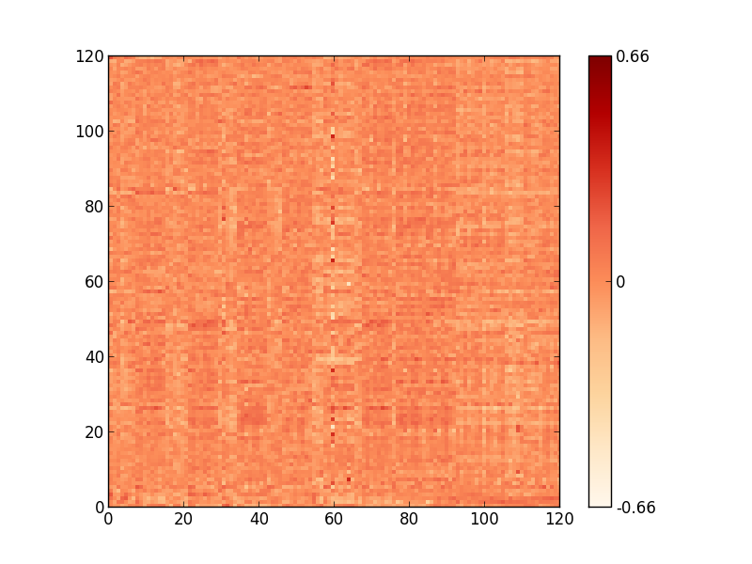
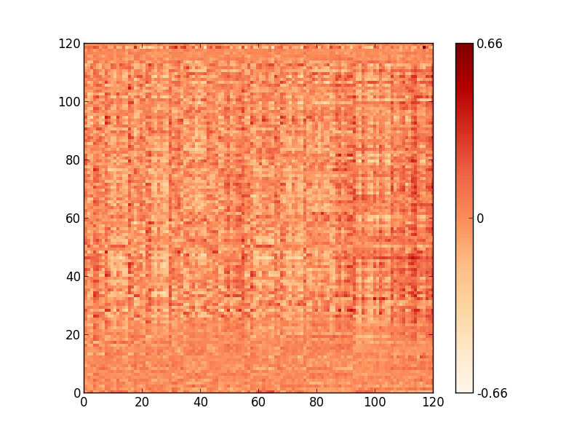
Time Variant Cross Correlation Samples
Dog_1 Interictal Segment 123
Dog1 Preictal Segment 14

Slide 9
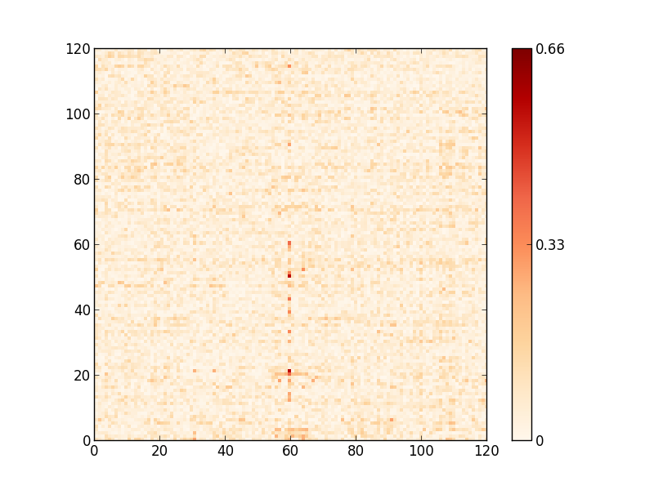
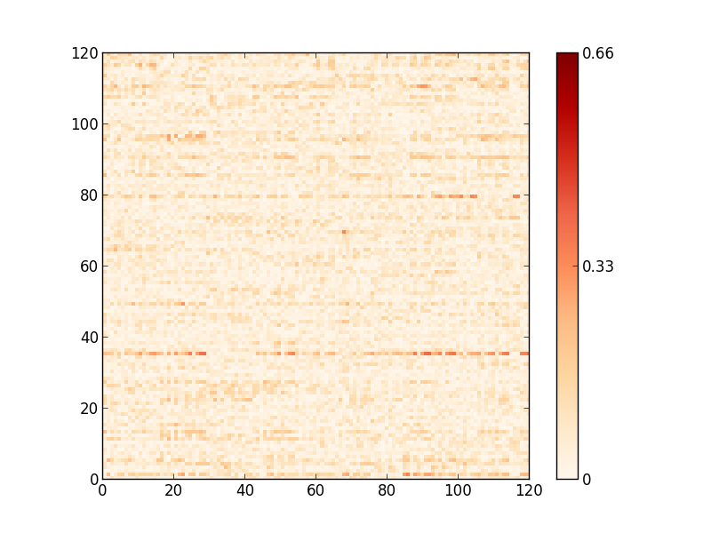
Time Variant Cross Correlation Samples (abs)
Dog_1 Interictal Segment 123
Dog1 Preictal Segment 14

Slide 10
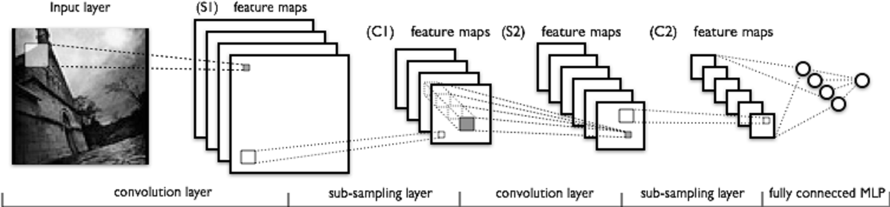
LeNet CNN Model
120x120
5@120x48
5@120x24
5@1x16
5@1x8
8
1
1x25
convolution
across time
1x4
subsampling
1x9
convolution
across time
1x2
subsampling
1x8
convolution
across time
Theano 0.6.0 LeNet
Python 2.7.3 / gcc 4.6.3
Numpy 1.9.0 / scipy 0.14.0
Lenet Parameters as above
Separate Model for Each Case
http://deeplearning.net/tutorial/lenet.html
http://deeplearning.net/tutorial/_images/mylenet.png

Slide 11
Performance
Amazon EC2 AWS g2.2xlarge
Ubuntu 12.04.4 LTS x86_64
NVIDIA Kepler GK 104 GPU
26 ECUs
8 vCPUs
2.6 GHz
Intel Xeon E5-2670
15 GiB memory
1 x 60 GiB Storage Capacity
Theano LeNet
MNIST data set
Accuracy
0.92% on tutorial
0.92% on my setup
Speed
380.28m tutorial
552m on my setup

Slide 12
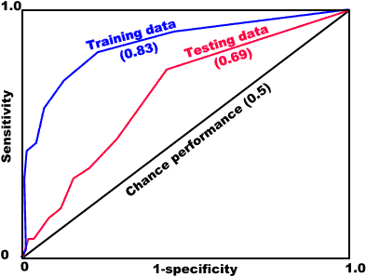
Results AUC
Actual Test Data is held at Kaggle.com
Results are blind
Results are aggregated across all casesc
TP%
AUC = TP/(TP+FP)
Actual Result not shown
FP%

Slide 13
Issues | Opportunities
Build multiple models for each case
Trains against full array of available seizures
Average results against bag of models
LeNet Convolution Model and Parameters
Step from 120x120 to 120x48 is steep
Maybe better arrangement of convolution/pooling
Maybe an additional Convolution and Pooling layer
Additional / Different Features
Additional bivariate features
“Tag on” univariate features

